Slide 1

Seam Carving Project
Nankai University | School of Software
Master in Software Engineering
First Semester Assignment - December 26, 2024

Slide 2
GROUP MEMBERS
Laggah Julius – ID: 2120246034
Jusu Abdul Karim – ID: 2120246025
Sandar Win – ID: 2120246058
Turay Zidida-Damekhaly – ID: 2120246056

Slide 3
INTRODUCTION
Seam carving is a content-aware resizing technique that preserves visually important areas. Unlike traditional resizing methods, it intelligently resizes images without distorting critical features.

Slide 4
PROJECT OBJECTIVES
- Implement intelligent image resizing with seam carving.
- Seam removal and insertion to preserve essential content.
- Maintain photorealistic quality of resized images.

Slide 5
METHODOLOGY
- Calculate energy maps to identify pixel that are importance through the x and y axis using the Sobel operator.
- Remove low-energy seams to shrink images.
- Add seams to enlarge images.
- maintain image quality to avoiding shrinking

Slide 6
Energy Map Calculation
The energy map is created by summing the absolute values of the image gradients in both the x and y directions for each pixel. This map highlights high-energy areas (important content) and low-energy areas (less critical regions) to guide seam selection.
The horizontal gradient (dx) and the vertical gradient (dy) are calculated using the sobel operator. These gradients highlight the edges in the image by detecting changes in the pixel intensity along the horizontal and vertical directions

Slide 7
Seam identification
Using dynamic programming, seams are identified through:
Initialization: The energy values of the first row are used to initialize the DP table.
Recurrence Relation: For each pixel ‘dp[i][j]’, calculate the minimum cumulative energy by considering the three pixels above it: ‘(i-1, j-1)’, ‘(i-1, j)’, and ‘(i-1, j+1)
Backtracking: Trace back from the pixel with the minimum cumulative energy in the last row to retrieve the seam.

Slide 8
Seam Removal and Insertion
At this point the seam with the lowest gradient or less energy concentration have already been identified
Seam Removal: Deletes pixels along a low-energy seam to reduce image size through the x and y axis.
Seam Insertion: Adds artificial pixels along a previously removed seam to enlarge the image.

Slide 9
IMPLEMENTATION
-install python
Libraries: NumPy, SciPy, Pillow.
- Input: Images and masks.
- Output: Resized images with preserved content.
- User interaction for specifying dimensions through the terminal.

Slide 10
SEAM CARVING ALGORITHM
- Input: Original image, target dimensions (New Width, New Height).
- Output: Resized image preserving important content.
Steps:
1. Preprocess image to compute energy map.
2. Identify seams using dynamic programming.
3. Remove or insert seams to achieve target size.

Slide 11
SEAM IDENTIFICATION AND REMOVAL FORMULA
- Dynamic Programming for Seam Identification:
- Compute cumulative energy for each pixel:
DP[i][j] = Energy[i][j] + min(DP[i-1][j-1], DP[i-1][j], DP[i-1][j+1]).
- Trace back minimum energy path (seam).
Seam Removal:
- Remove pixels along the identified seam.
- Update the energy map to reflect changes.

Slide 12
ALGORITHM CONCLUSION AND APPLICATION
Conclusion:
- Seam carving enables content-aware resizing with minimal distortion.
- It supports resizing and image while preserving visual quality.
Applications:
- Image resizing for web and mobile platforms.
- Intelligent cropping for photography.
- Object removal in photo editing.

Slide 13
CHALLENGES AND SOLUTIONS
Challenges:
- Accurate energy map calculations.
- Performance optimization for large images.
- Maintaining photorealism.
Solutions:
- Advanced filters for energy maps.
- Optimized algorithms for large-scale processing.

Slide 14
ACHIEVEMENTS AND FUTURE IMPROVEMENTS
Achievements:
- Intelligent resizing with minimal distortion.
- Flexible object removal and resizing.
Future Improvements:
- Real-time processing with GUI.
- Enhanced precision for object removal.
- Optimization for larger datasets.

Slide 15
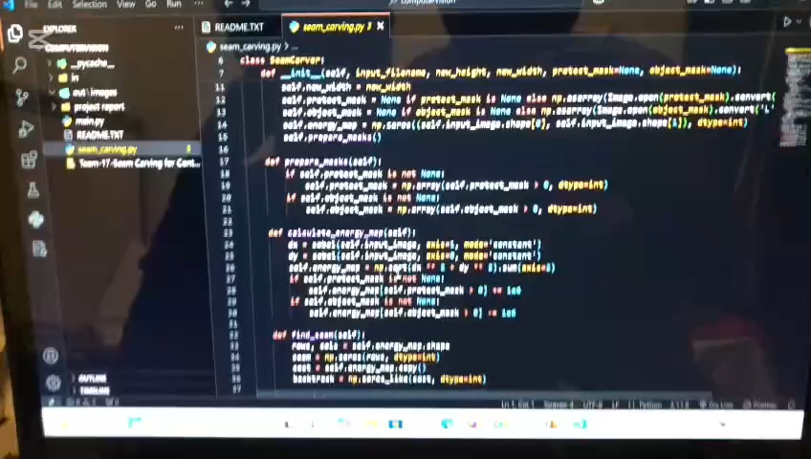
A quick Demo of the project

Slide 16


Comparison of images
Input image before seam carving 500 x 339
Output image after seam removal and insertion 350 x 400

Slide 17
CONCLUSION
The seam carving project successfully implemented content-aware resizing. It preserves important content, supports object removal, and ensures minimal distortion. Future improvements include GUI development and advanced object handling.

